Slide 1
Offline Access With RN
Tyson Kunovsky | Principal - Inspire11 Consulting

Slide 3
Offline access – questions to consider
Are we truly “online” and what does that mean?
What makes a good offline experience for an app?
If a user is offline, how do we save data for later use and make sure the data is saved in a usable format?
How do we make offline access work with commonly used libs redux-form?
How do we create a good developer experience?
Should we automatically try and do stuff with saved data when a user comes back online? (no for this example – but easy to implement)
Notes:
- We only want to allow users to submit data if they have a connection that works.

Slide 4
Tech you will see in this talk
React Native (+ Expo)
Native Base
React Native Offline
Redux
Redux Persist
Redux Form
Recompose
Higher Order Components
Notes:
This talk assumes a working knowledge of react native, redux, recompose, and higher order components. It is meant to be a simple explanation of how to add basic offline capabilities to any react native app.
Talk about what is not covered

Slide 5
Step 1 - React Native Offline
Notes:
- Most basic thing we need to do it check to see if a user is online, and if not, do something

Slide 6
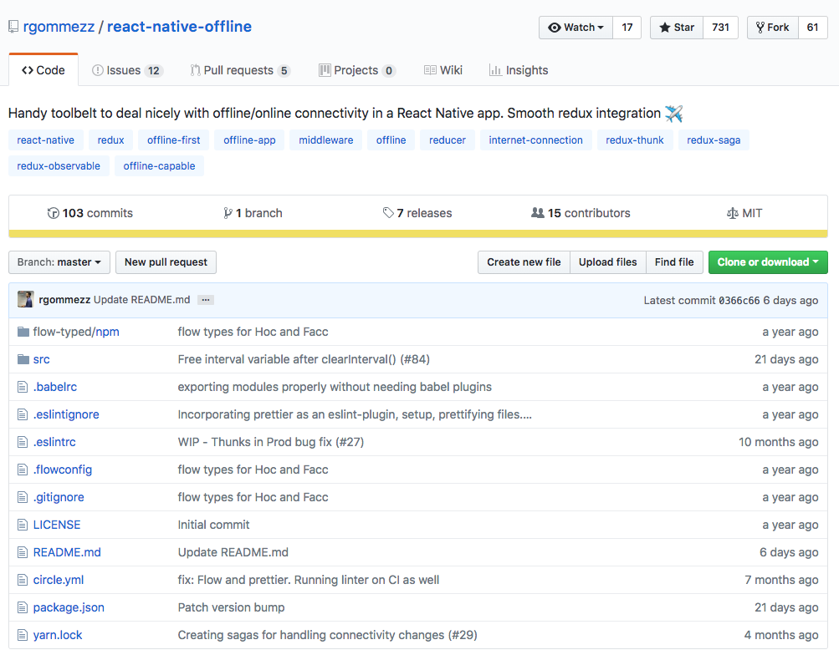
https://blog.callstack.io/your-react-native-offline-tool-belt-795abd5f0183
Notes:
Those of you who have had to build connectivity dependent apps before might ask, why not just NetInfo - React Native ships with the NetInfo module in order to detect internet connectivity. The API is pretty basic and it may be sufficient for small apps but its usage gets cumbersome as your app grows. Besides that, it only detects network connectivity and does not guarantee internet access so it can provide false positives.

Slide 7
How does it work?
Uses the NetInfo module from RN under the hood.
NetInfo by itself presents downside, its API allows you to detect network connectivity, but it does not guarantee you can exchange data with a remote server even though it reports you are connected.
It can tell if you actually have connectivity by pinging a remote server of your choice using a http HEAD request.
Can be integrated directly with redux if you like.
For our simple implementation we can use withNetworkConnectivity
Notes:
React Native ships with the NetInfo module in order to detect internet connectivity. The API is pretty basic and it may be sufficient for small apps but its usage gets cumbersome as your app grows. Besides that, it only detects network connectivity and does not guarantee internet access so it can provide false positives.

Slide 8
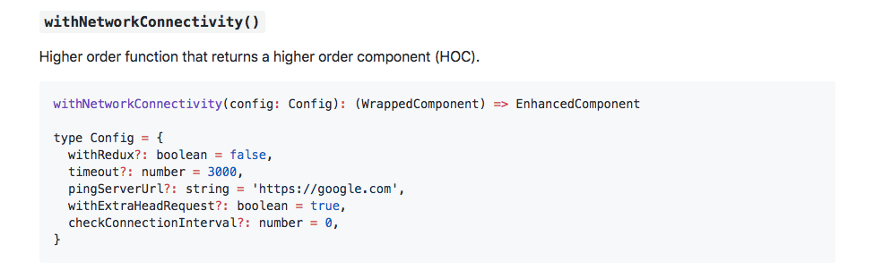
withNetworkConnectivity
https://github.com/rgommezz/react-native-offline
Notes:
withRedux: flag that indicates whether the HoC should be wired up to the Redux store. By default, this parameter is false and the HoC injects isConnected as a prop into WrappedComponent. If true provided, it won't act as a component utility and pass any prop down, but instead perform the needed actions to sync up with the store. See below Redux integration for more details.
withRedux: flag that indicates whether the HoC should be wired up to the Redux store. By default, this parameter is false and the HoC injects isConnected as a prop into WrappedComponent. If true provided, it won't act as a component utility and pass any prop down, but instead perform the needed actions to sync up with the store. See below Redux integration for more details.
timeout: amount of time (in ms) that the component should wait for the ping response. Defaults to 3s.
pingServerUrl: remote server to ping to. It defaults to https://google.com since it's probably one the most stable servers out there, but you can provide your own if needed.
withExtraHeadRequest: flag that denotes whether the extra ping check will be performed or not. Defaults to true.
checkConnectionInterval: the interval (in ms) you want to ping the server at. The default is 0, and that means it is not going to regularly check connectivity.

Slide 9
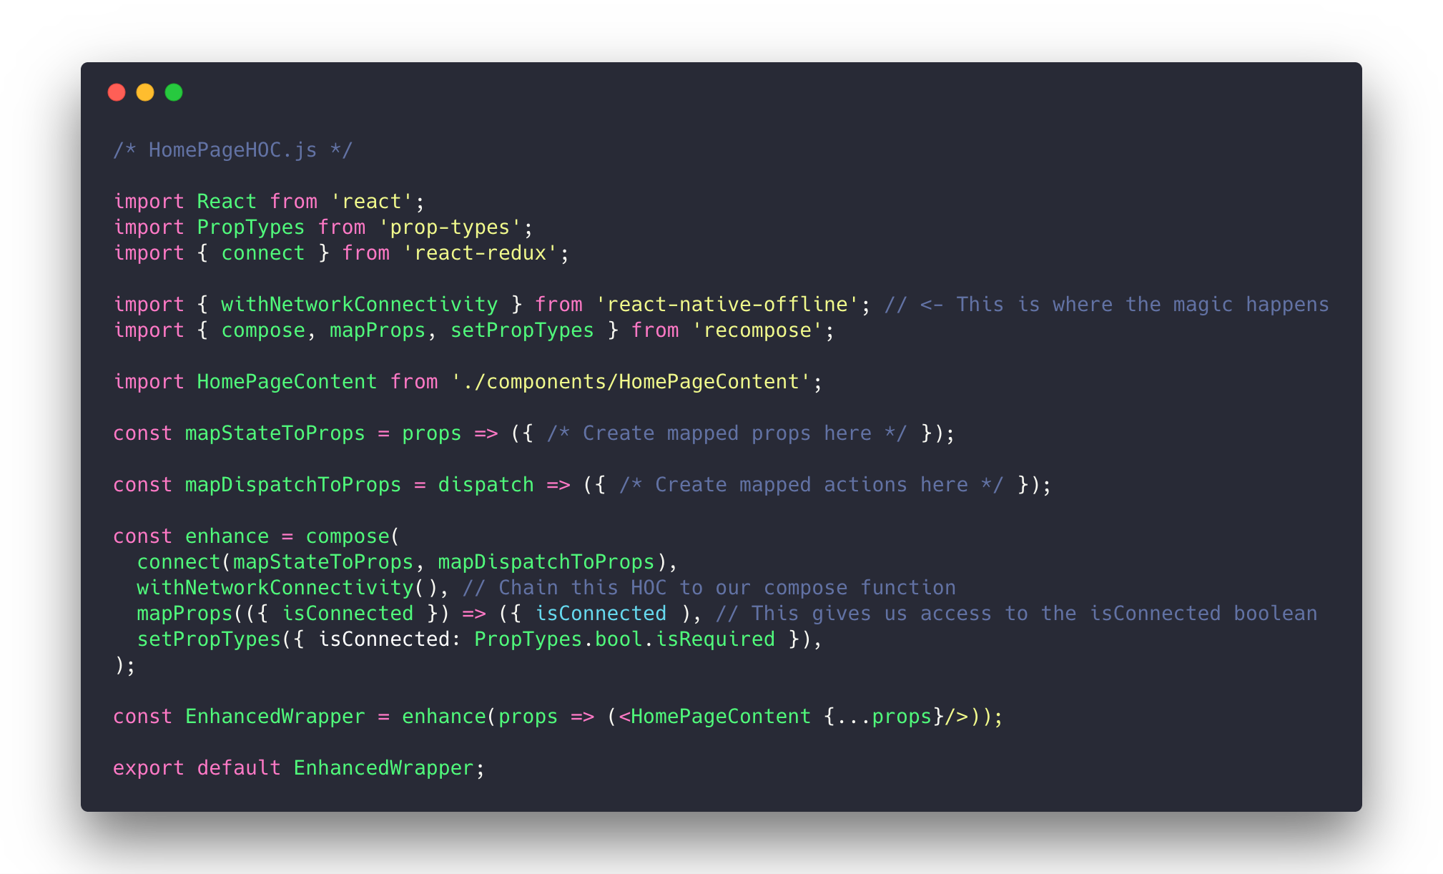

Slide 10
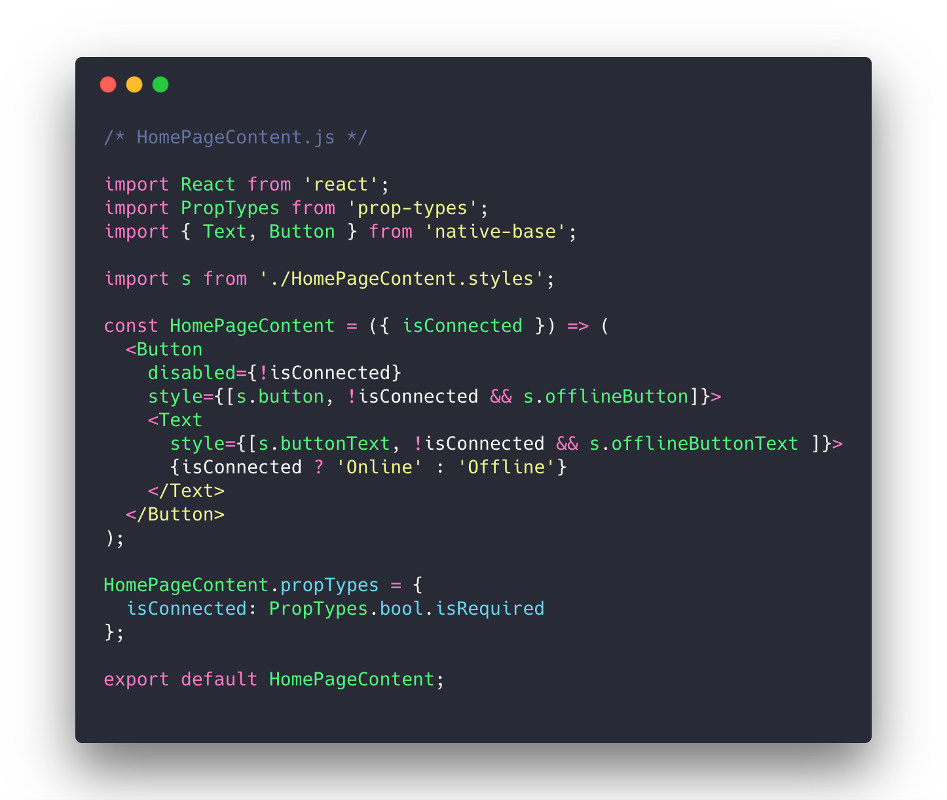

Slide 11
Step 2 - Redux Persist

Slide 12
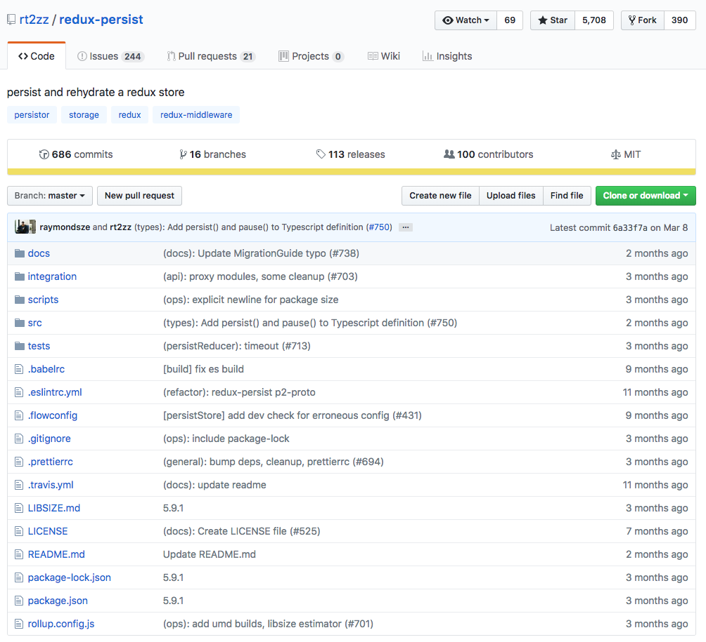
Notes:
What about saving our data?

Slide 13
How does it work?
Takes your reducer state and saves it locally, defaults to localStorage for web and AsyncStorage for react-native.
Can “whitelist” only certain reducers, or all the reducer.
State reconcilers define how incoming state is merged in with initial state – make sure to choose the right one for your needs.
Allows you to customize how data is saved and then hydrated, very useful for transforming data.

Slide 14
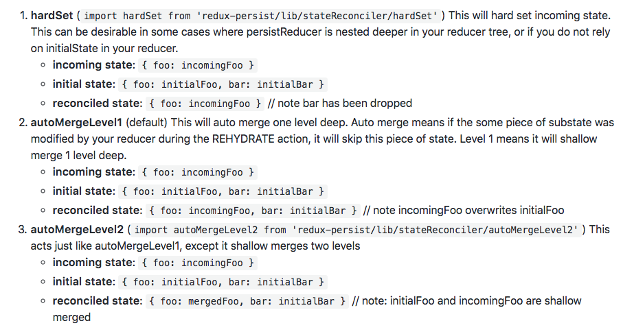
https://github.com/rt2zz/redux-persist#state-reconciler

Slide 15
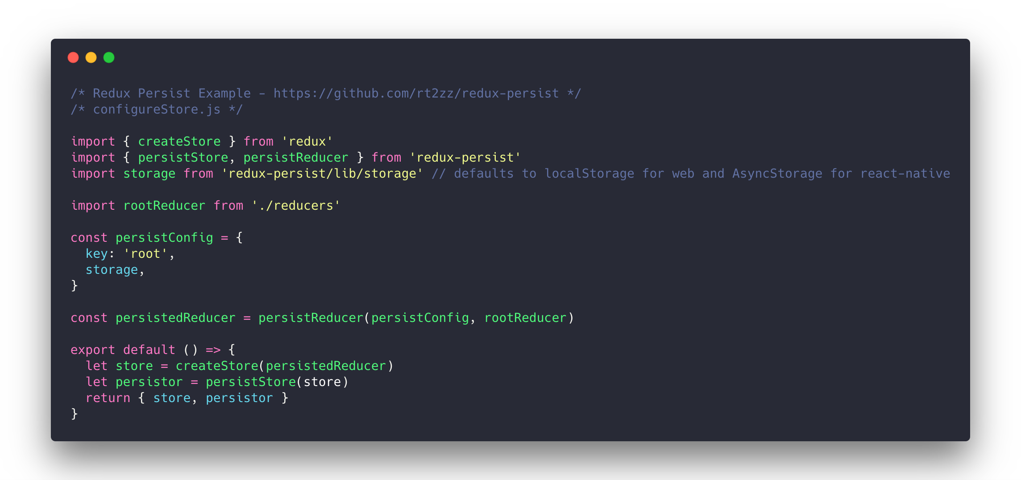

Slide 16
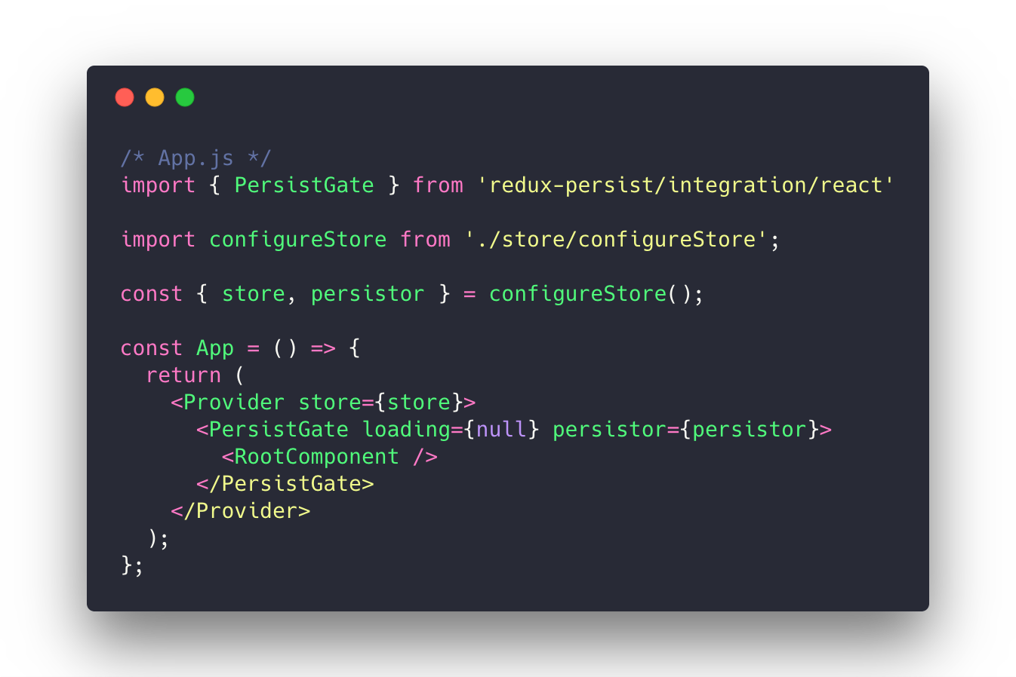

Slide 17
That’s it! (mostly)

Slide 18
Step 3 – Get it working with redux-form

Slide 19
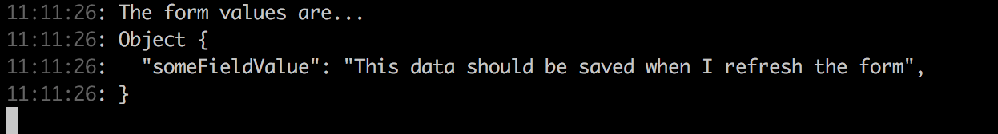

Redux Form – ensure form data saves
When we refresh the app form data is not getting hydrated properly….
Expected this:
But got this:
Notes:
Hooked this up and everything was working fine, except for the form reducers.
Turns out that the form reducer was re-initializing itself, and ignoring the values that were stored under the “form” key in AsyncStorage by redux-persist

Slide 20
Solution
Write a transform to populate initialValues on hydrate of the app
https://github.com/rt2zz/redux-persist#transforms
Notes:
To solve this problem, we can do the same thing we would do if we were loading in data from a remote server and displaying it in the form – the best way to initialize existing values into a form is to just pass an “initialValues” to that form.

Slide 21
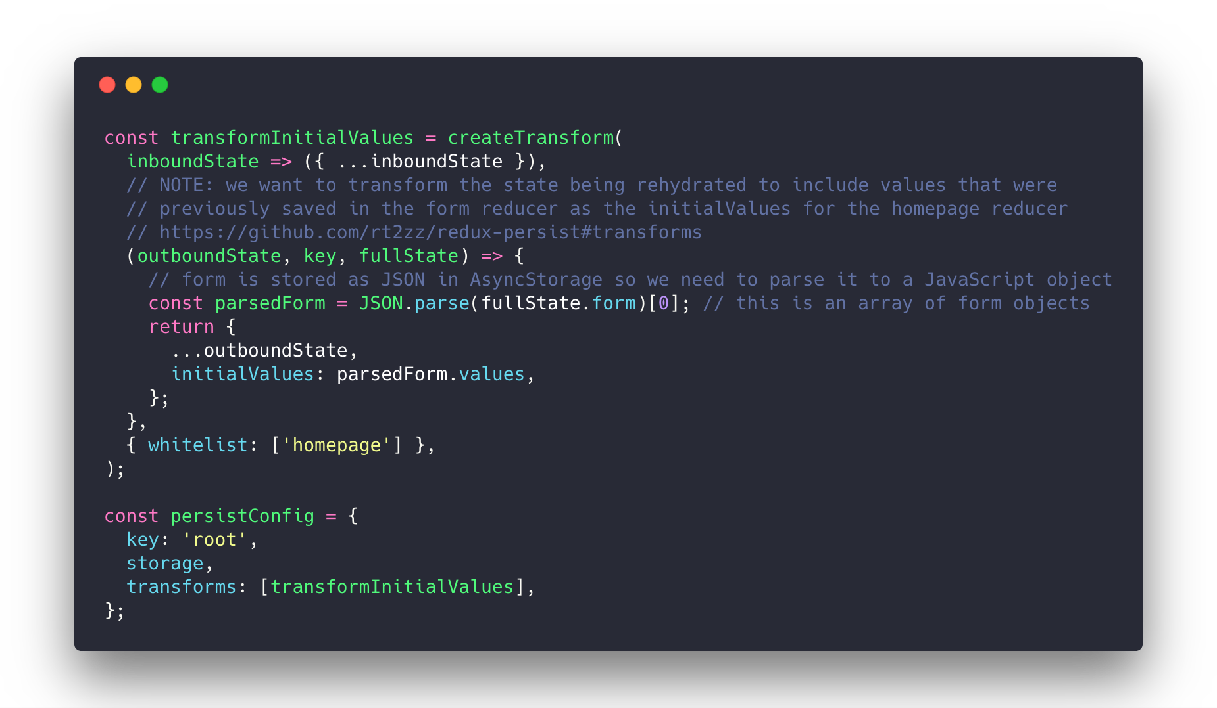
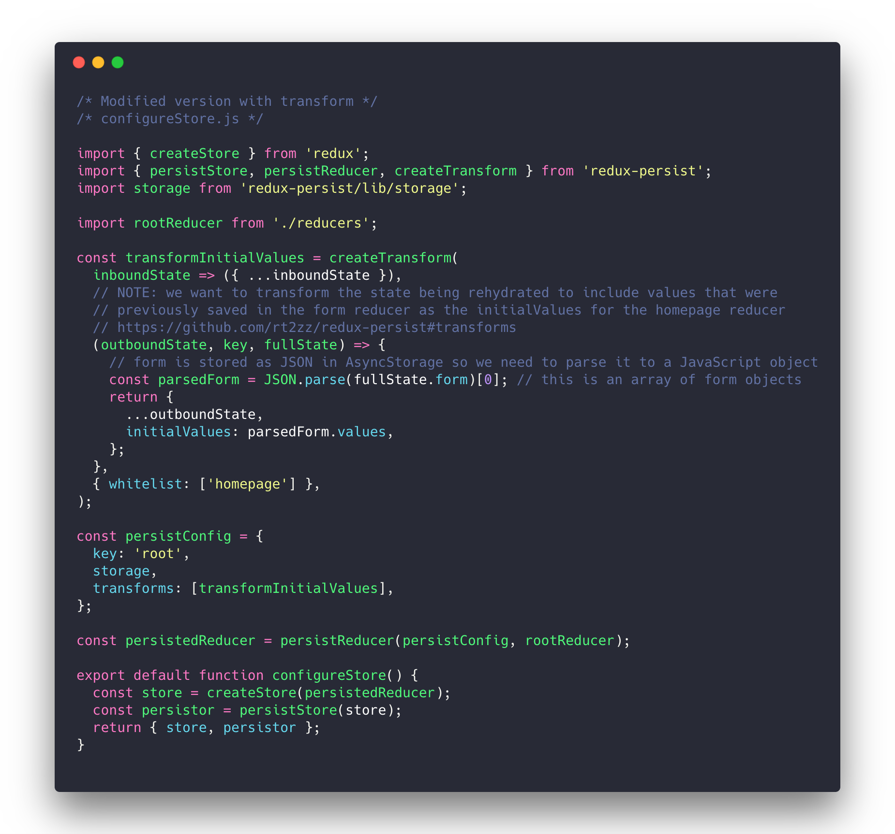
Notes:
- When the state object gets persisted, it first gets serialized with JSON.stringify()

Slide 22
Step 4 – Solid dev experience

Slide 23
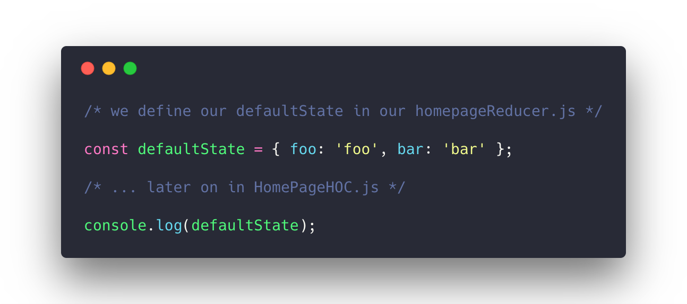
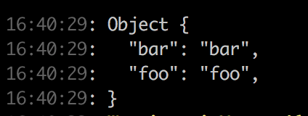
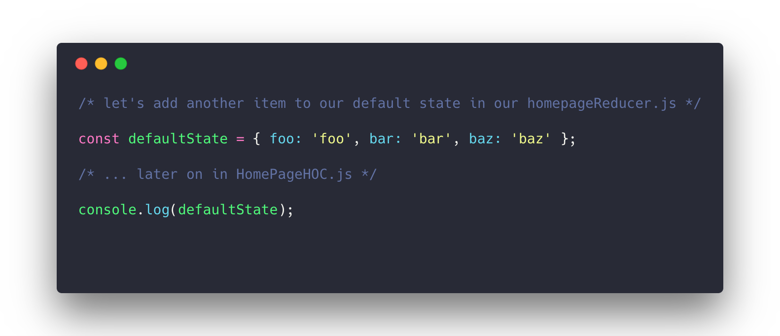
😄
😭
Notes:
- When we add a new item to our reducer state… the state of the app is not updating

Slide 24
What happened to baz?
Store is now being persisted between refreshed, but new values were not appearing in the reducer when we add them…

Slide 25
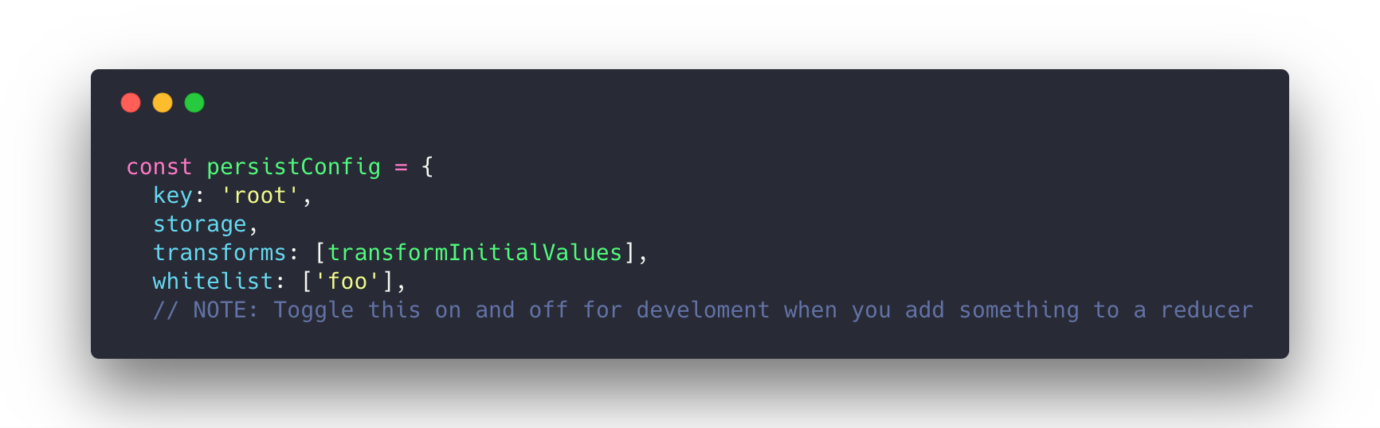
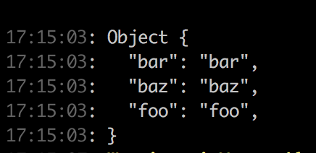
Development Work Around
We need to nuke the current state of the app when we add something to a reducer by telling redux persist to only save date for the “foo” reducer (which does not actually exist). All other data is dropped.
Notes:
- This can be a bit annoying, a better solution for some might be to whitelist only the reducers that you want to save.

Slide 26
Resources
https://github.com/rt2zz/redux-persist
https://github.com/rgommezz/react-native-offline
https://blog.callstack.io/your-react-native-offline-tool-belt-795abd5f0183 <- good article on react-native-offline by its creator
https://github.com/kunovsky/reactOfflineTalk <- slides and code from this talk

